Slide 1
CASE STUDY-1 GOOGLE PROJECT OXYGEN (Raise an Ambitious Boss)
By -
SUJAY GS
VAISHAK P
THIRUMALAI SHAKTIVEL C

Slide 2
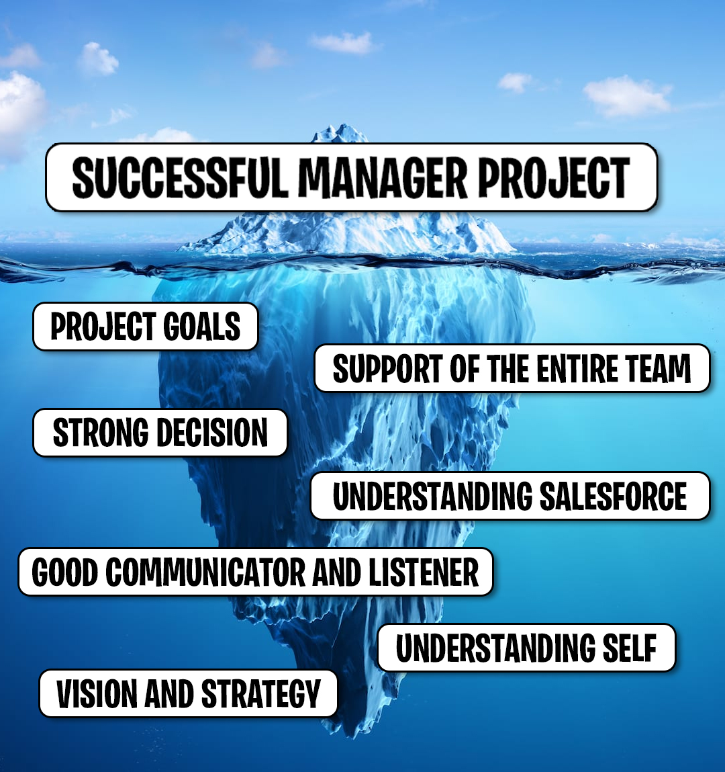
This case study is based on the project oxygen by the Google. It mainly tells us how the Google SOLD it’s engineers on management.
Here are the few points:-
A manager should be able to take the strong decision at the right time.
To become a good manager he should be a good listener and also a good communicator so that information shared will be effective.
Should be having the clear vision on what should be done when and should have the strategy for the teams.
Proper project goals to get the required results.
SUJAY GS

Slide 3

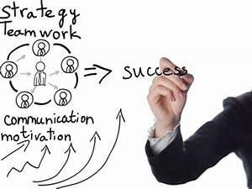
Few roles of a good manager
Good managers doesn’t solve the problems on the spot. They do take those challenges as teachable moment and guide the team. This helps the team to solve the problems on their own with the help of guidance.
The managers take the decisions firmly. Once the decision is made they will stand with it.
A good managers should work for the empowerment of the team and grant them the freedom so that they get the ability to manage their own environment to meet their objectives.
Google’s 20% time resulted in popular products such as Gmail and AdSense. While there are rumors that this is not an official policy of Google anymore, as a manager, encouraging employees to take some time to work on an innovative new project they’ve pitched can bring you great products and loyalty from motivated employees.
THIRUMALAI SHAKTIVEL

Slide 4

Project Oxygen
In an environment where the conventional is always challenged, Google’s People Innovation Lab started
Project Oxygen trying to prove that manager quality does not have an impact on performance.
To prove this point they hired a group of statisticians to evaluate the differences between the highest and lowest rated managers.
Data was collected using past performance appraisals, employee surveys, interviews and other sources of employee feedback.
However, instead they proved that good management actually makes a difference. To better define what makes
a good manager they came up with a list of few qualities based on the data received.
Google’s Project Oxygen findings:-
Is a good coach.
Empowers the team and does not micromanage.
Expresses interest in and concern for team members’ success.
Helps with career development.
Has key technical skills that help him or her advise the team.
VAISHAK P

Slide 5
THANK YOU

